Slide 1

The LL(1) Parsing Algorithm
ECM3428: Algorithms that changed the world
Notes:
This is my video on the LL1 parsing algorithm

Slide 2
Background
The LL(1) algorithm is a parser.
Takes a grammar and input string of tokens and outputs whether the input can be generated from the grammar.
Scans from left-to-right to find the leftmost derivation with 1 token of lookahead.
Works on a subset of context-free grammars.
Input
Tokens
LL(1)
Valid?
Grammar
Notes:
This algorithm is a parser
That means it takes a grammar and input string of tokens, and returns whether or not that input can be generated from the grammar
It is called LL1 because it scans the input from left to right to find the leftmost derivation with only one token of lookahead
Because it uses only one lookahead token it can only do this for a subset of grammars, called LL1 grammars

Slide 3
Principles
Grammar
Requires an input buffer, stack, and parsing table.
The parsing table is precomputed from the grammar.
Let X be the symbol on the top of the stack, and a the current input token:
If X = a = $, the input is valid.
If X = a, pop X and advance to the next input token.
If X is a nonterminal, pop X and push Table[X, a] to the stack.
Identify a syntax error if Table[X, a] is empty.
Table
Gen.
Parse Table
Input Buffer
Stack
Input
Tokens
LL(1)
Valid?
Notes:
The algorithm uses an input buffer, stack, and parsing table
This parsing table is precomputed by a different algorithm from the grammar
This algorithm is explained in my written report and my implementation
The parsing algorithm works as follows
If the symbol on the stack and current input token are both the special end of string marker, normally denoted dollar, then the input is valid
If they are otherwise the same, we pop X and advance along the input
A special case of this is when X is the special empty nonterminal, where we do not advance along the input as we have correctly read an empty string
If X is a nonterminal, it is replaced by the production in the parsing table at cell X, a
The two cases where an invalid input is detected is if X is a terminal but different from a, or if the cell at X, a is empty
Let’s look at some examples

Slide 4
> cargo run "1+(6+7)"
Tokenised:
‘1+(6+7)' => [id, +, (, id, +, id, ), $]
stack | input | action
$E | id+(id+id)$ | E -> TE'
$E'T | id+(id+id)$ | T -> FT'
$E'T'F | id+(id+id)$ | F -> id
$E'T'id | id+(id+id)$ | 'id'
$E'T' | +(id+id)$ | T' -> ε
...
$ε | $ | 'ε'
$ | $ | '$'
Valid input: true
Notes:
With my implementation I have provided a grammar for basic arithmetic expressions
[click]
Running it on this valid input gives the following output
[click]
First the input is tokenised
Notice how specific numbers are replaced by identifier tokens, as the parser does not care about what these values actually are
Also see how the end of string token has been added to the end
[click]
We then see the state of the parser’s stack and input, as well as the actions it is taking
See how nonterminals are replaced by productions from the parse table, and matching terminals are popped
Eventually the input and stack both contain only the end of string marker, and the parser returns true

Slide 5
> cargo run "1+(6+7"
Tokenised:
'1+(3+6' => [id, +, (, id, +, id, $]
stack | input | action
$E | id+(id+id$ | E -> TE’
...
$E'T')E'T'id | id$ | 'id'
$E'T')E'T' | $ | T' -> ε
$E'T')E'ε | $ | 'ε'
$E'T')E' | $ | E' -> ε
$E'T')ε | $ | 'ε'
$E'T') | $ | Syntax Error: Expected ')', found '$’
Valid input: false
Notes:
With this invalid input, the parser correctly identifies that we are missing a closing bracket
With little effort a helpful error message is provided

Slide 6
Importance
Used where high performance is needed, for example syntax highlighting in IDEs.
Domain specific languages (SQL, JSON).
Can be verified.
Where LL(1) is O(n), algorithms to parse harder languages (C++, Python) are up to O(n³).
Notes:
This algorithm is important when a high performance parser is needed
An example is syntax highlighting in an editor, where the language’s grammar can be simplified to LL1 because we only need to highlight it, and so this algorithm can be used to efficiently parse it
Domain specific languages like SQL and JSON are also LL1
Another advantage is that LL1 parsers can be verified to produce the correct result, which may be important in security focused fields
As you can see, compared to the more complex parsers needed for languages like C++ and Python, LL1 has much lower time complexity

Slide 7
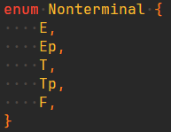
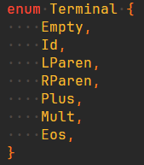
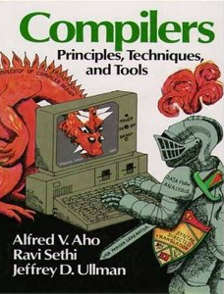
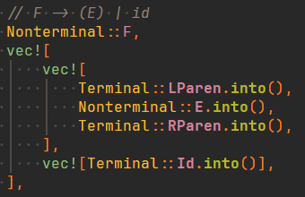
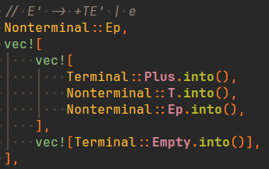
Implementation
Grammar definition
Table generator
Parsing
Grammar
Table
Gen.
Parse Table
Notes:
My implementation has three parts: a grammar definition, table generator, and the parser itself
The provided grammar is one for arithmetic expressions and is taken from the dragon compiler book
A source for this is at the end
The definition requires enums for the possible terminals and nonterminals, and a vector of production rules written as shown
Notice how the right hand side of the production is a vector to allow for multiple productions from the same nonterminal
A table is then generated from this grammar and given to the parser

Slide 8
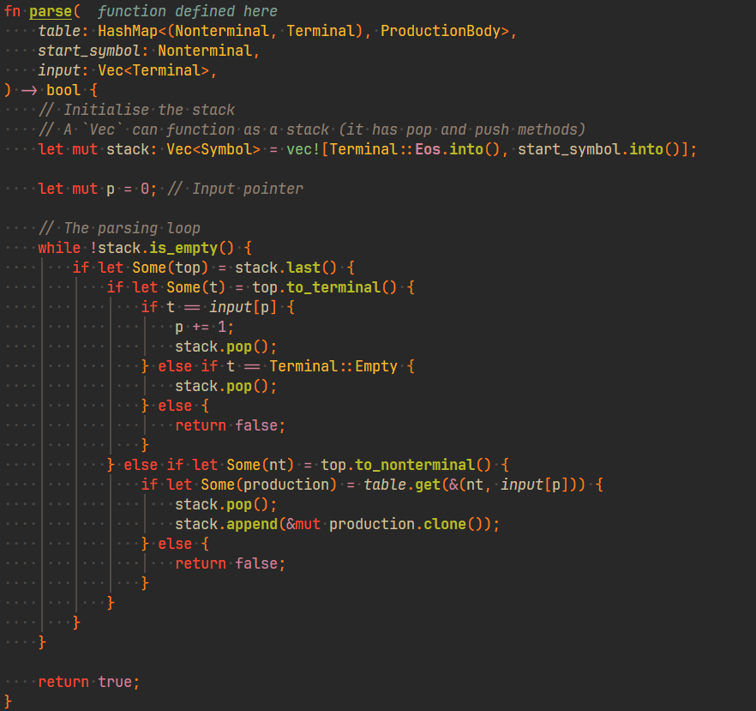
Notes:
Here is an abbreviated look at that parser
It starts by initialising the stack with the start symbol on top and end of string marker on the bottom, and the input pointer to the start of the input
We then repeat until the stack is empty
If the sumbol on the top of the stack is a terminal, we compare it to the current input token
If they are the same, the input contains the nonterminal we were expecting
We pop from the stack and advance the input
If we are expecting an empty terminal, we pop from the stack without advancing the input
Otherwise, the input contains a terminal we were not expecting and so the parser returns invalid
If the top symbol on the stack is a nonterminal, then we perform a lookup on the table
If the cell contains a production, we replace the current top stack item with it
Otherwise, we have an invalid input and the parser returns
If we consume the whole input and stack, then the input was valid

Slide 9
[1] A. V. Aho, R. Sethi, and J. D. Ullman, Compilers: principles, techniques, and tools. Addison-Wesley, 1988
Notes:
Here’s a reference to the dragon compiler book
Thank you for watching

